Slide 1


IMARTICUS LEARNING
PG Diploma Data Analytics and Machine Learning (Batch – PGA21)
Start Up Data Prediction (Capstone Project)
Presented by
Akanksha Singh
Ayush Gupta
Pankaj Verma
Under the guidance of
Utkarsh Tiwari Sir

Slide 2
Agenda
Introduction
Problem statement
Objectives
Tools and technologies
Process
Algorithms
Model conclusion
Data dashboard
Important insights

Slide 3
Introduction
Startups play a major role in economic growth. They bring new ideas, spur innovation, create employment thereby moving the economy. There has been an exponential growth in startups over the past few years.
The total count of Indian tech startups that have ever entered the unicorn club (Companies having worth more than $1 BILLION) till date stands at 107. These 107 Indian unicorns have raised more than $94 Billion in funding to date and are valued at around $344 Billion combined.
Countless startups are being launched every day in India. Many fail because they did not learn from the success of other companies who’ve managed to rise above.
Thus preventing start-ups failure has become a mandatory factor for the entrepreneurs as it squander their time money, and efforts but good data-driven systems for predicting startup success / failure can improve the entire research and prevention process making sure that every entrepreneur planning to start his / her business can drive it to the success. This is where Machine Learning comes into play. Machine learning helps in predicting the Success / failure of the startups and predictions made are quite accurate.

Slide 4
Problem Statement
To analyse and predict whether a startup is going to acquired or closed by applying different machine learning algorithms.
Input Variables - state_code, zip_code, Name, City, labels, Founded_at, Closed_at, First_funding_at, last_funding_at, funding period, avg_participants, is software, is web, is mobile, is enterprise, is advertising, is gamesvideo, age_first_funding_year, age_last_funding year, age_first_milestone_year, age_last_milestone_year, relationships, funding rounds, is ecommerce, is biotech, is consulting, is othercategory, has vc, has angel, has round A, has round B, has round C, has round D, total rounds, is top_500.
Output Variables - Status

Slide 5
Objective
The objective is to predict whether a startup which is currently operating turns into a success or a failure.
To use more accurate algorithm for prediction by comparing the Algorithms.
To make a bridge between the entrepreneurs and their startup success.
To Predict whether the startup will be acquired or rejected.

Slide 6
Tools And Technologies
MICROSOFT EXCEL
PYTHON PROGRAMMING
PANDAS
NUMPY
SKLEARN
MATPLOTLIB
SEABORN
POWER BI
MICROSOFT POWERPOINT

Slide 7
Process
Conducted Research for collecting data.
Data Processing .
Splitting data into Training and Testing.
Trained the Data by applying different algorithms.
Boosted the Model and made the predictions.
Evaluated the Model
Represented the predictions on visualization tool.

Slide 8
1. Data Research
As we know, Startup failure is common now a days. In addressing this concern, we came up with an idea of creating such models which predict if a startup will fail or succeed including all the factors that affect the failure and success of a start-up.
While doing research on this we found the relevant dataset from Kaggle and started working on the idea of preventing startup failure.

Slide 9
2. Data Processing
Dropped the insignificant columns – like s.no, closed at, founded at, labels, latitude, longitude, state code .
Applied the label encoder in cat_cols like state code, zip code, city, name, category code.
checked for outliers using boxplot.
handled the outliers.
checked for multicollinearity using heat map.
standardized the data.
3. Splitting Data
After all the cleaning and processing data has been split into training with 75%, and testing with 25% respectively.

Slide 10
4. Algorithms
Decision tree:
Decision-tree algorithm falls under the category of supervised learning
algorithms.
A decision tree is a flowchart-like structure in which each internal node represents a "test" on an attribute , each branch represents the outcome of the test, and each leaf node represents a class label .
The decision tree from the name itself signifies that it is used for making decisions from the given dataset. The concept behind the decision tree is that it helps to select appropriate features for splitting the tree into subparts.
Training score = 0.91763005780
Testing score = 0.844155844155

Slide 11
Random Forest:
Random forest algorithm falls under the category of supervised learning algorithms.
Random forest builds multiple decision trees and merge their predictions together to get a more accurate and stable prediction rather than relying on individual decision trees.
Random forest, like its name implies, consists of a large number of individual decision trees that operate as an ensemble. Each individual tree in the random forest generates a class prediction and the class with the most votes becomes our model’s prediction.
Training Score = 0.8945086705
Testing Score = 0.8311688311

Slide 12
Logistic Regression:
Logistic Regression is a supervised learning algorithm used for classification.
Logistic regression transforms its output using the logistic or sigmoid function to return a probability value which can then be mapped to two or more discrete classes.
Logistic Regression is a special case of linear regression where the target variable is categorical in nature. It uses a log of odds as the dependent variable. It predicts the probability of occurrence of a binary event utilizing a logit or sigmoid function.
Training Score = 0.6459375722
Testing Score = 0.6493506493

Slide 13
Naive Bayes:
Naive Bayes is a supervised learning algorithm used for classification based on Bayes’ Theorem.
Naive Bayes intuition every pair of features being classified is independent of each other.
The fundamental Naive Bayes assumption is that each feature makes an independent and equal contribution to the outcome.
Training Score = 0.3627167630
Testing Score = 0.3549783549

Slide 14
5. Model Boosting
Adaboost Classifier:
Adaboost Classifier is a supervised learning algorithm used for classification.
In Adaboost Classifier, trees are just a node with two leaves. They are called stumps. Stumps are weak learners as it will only use one variable to make decisions.
In AdaBoost many different Decision stumps are combined sequentially .
Training Score = 1.0
Testing score = 0.8614718614

Slide 15
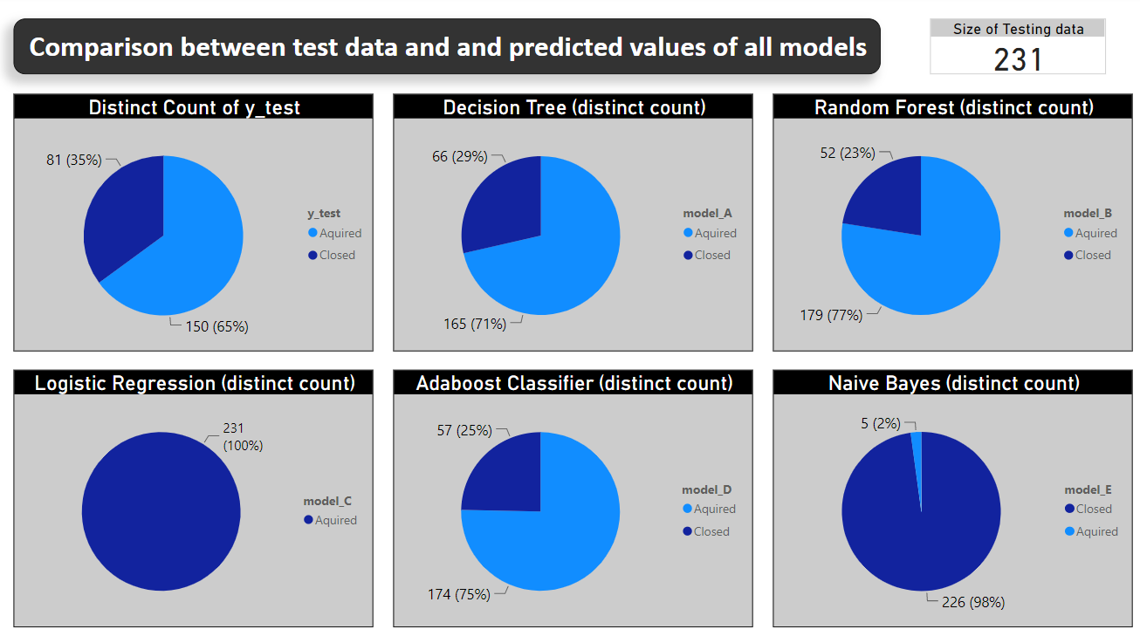
6. Model Predictions
First chart shows the percentage of Status from original data.
Predictions clearly shows that the percentage and count of Decision Tree Model are very accurate to the y_test (original data).
As we can see in the charts, the accuracy with Logistic Regression and Naive Bayes models are very poor.

Slide 16
Conclusion
Among all the above given classification we get that decision tree gives us best training score and accuracy. With this we can further use Decision Tree in the start up data in future for accurate predictions.
This will help entrepreneurs to :-
Prevent losses.
Save their time and efforts.
Find companies that have the potential for rapid growth.
This will allow them to stay one step ahead of the competition.

Slide 17
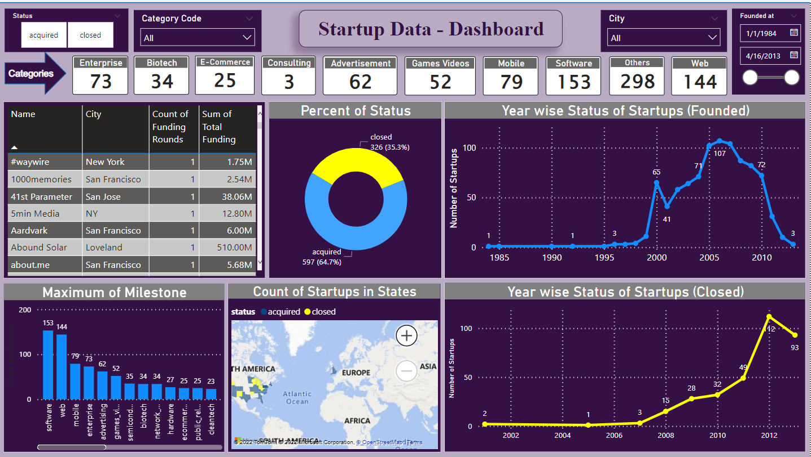
Dashboard View
Content
Filters
Dropdown – Category code and City
List – Status
B / W Slider – Founded_at
Cards
Different categories count as in the data.
Charts
Text Table.
Donut chart of Status.
Two Line chart (Founded and Closed).
Bar chart of Maximum of Milestones.
A map showing the status
By Hovering on any chart we can see all the related details of the required charts

Slide 18
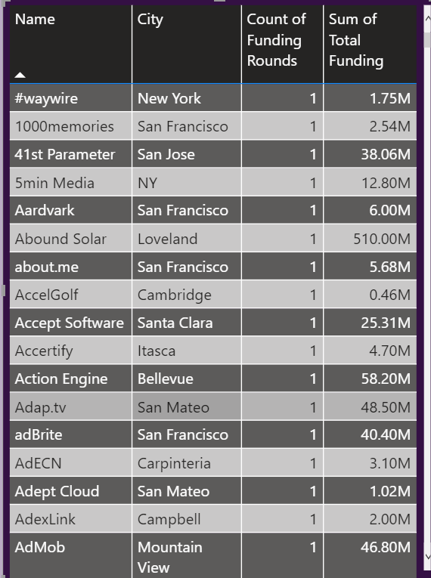
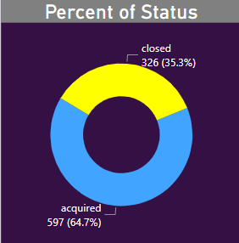
Dashboard Charts
In the dashboard first we made the cards of different categories in which we have shown the count of each important category.
The text table consist of names of each and every individual startups, their city, count of funding rounds and Total funding.
The donut chart shows us the percentage of status closed(Yellow) or acquired(blue).

Slide 19
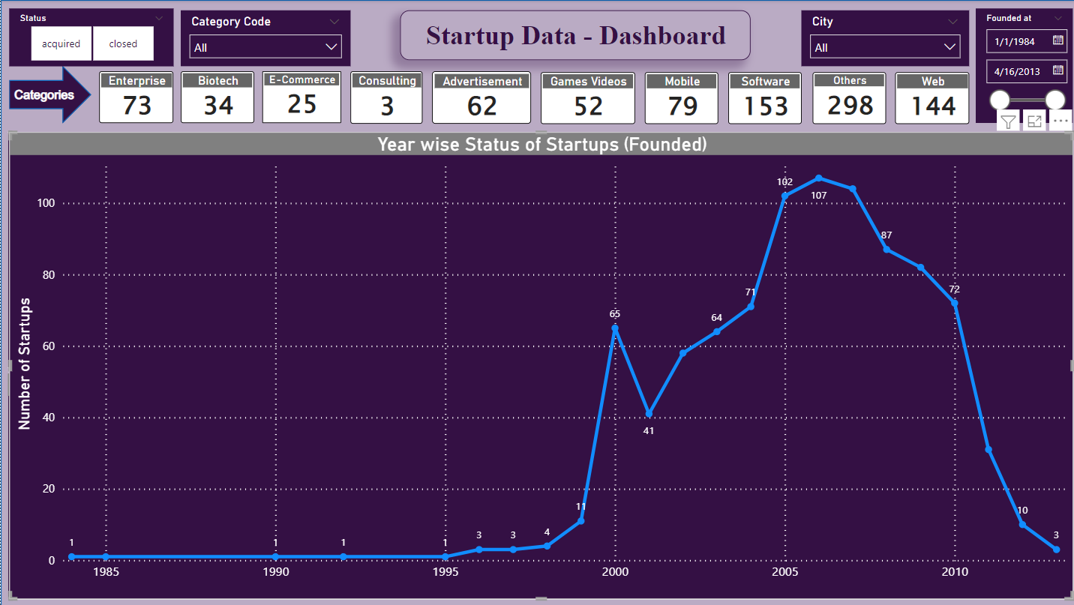
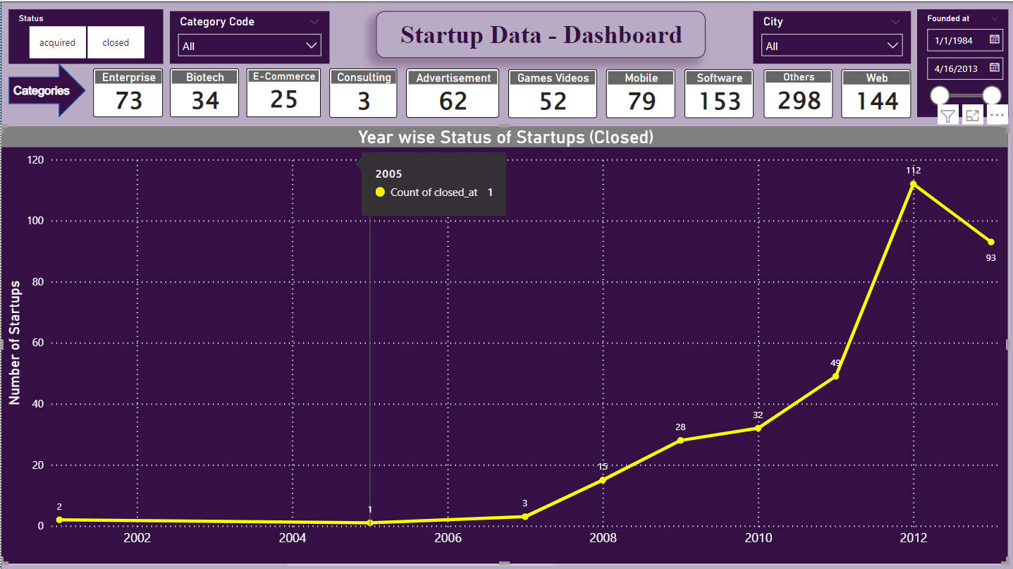
The Line charts with blue color show us the number of startups that were founded between 1984 to 2013.
Another Line charts with yellow color show us the number of startups that were closed between 2001 to 2013.

Slide 20
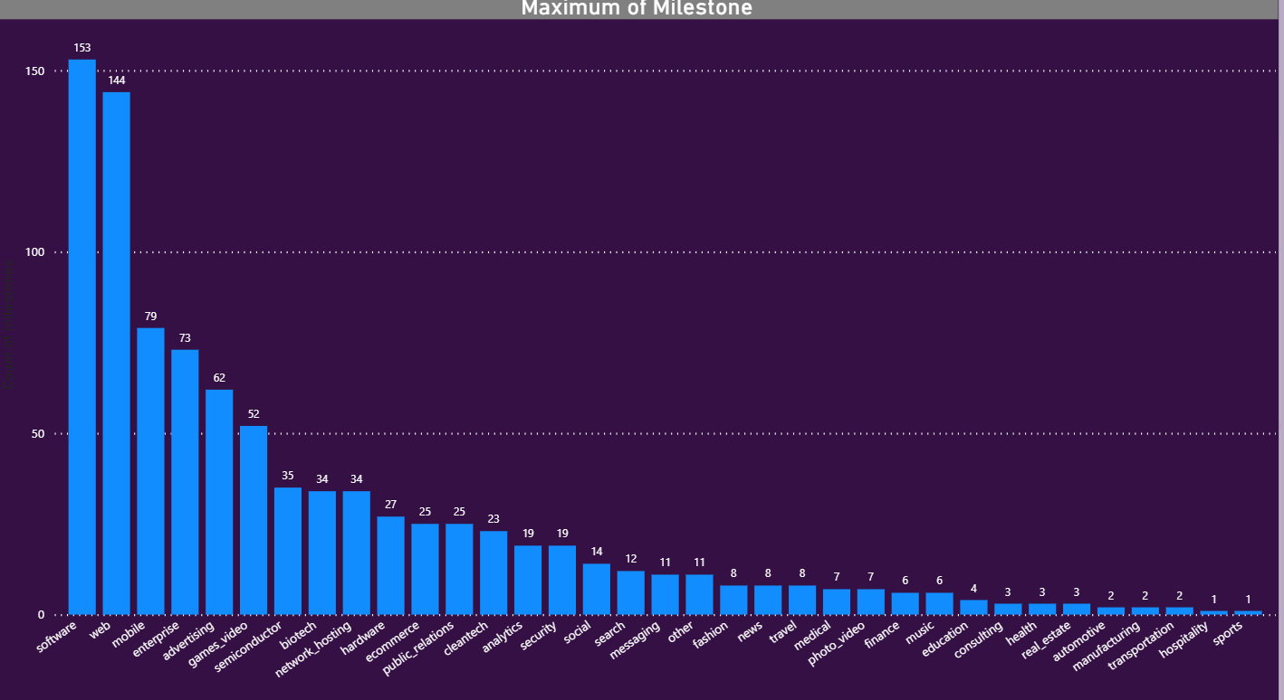
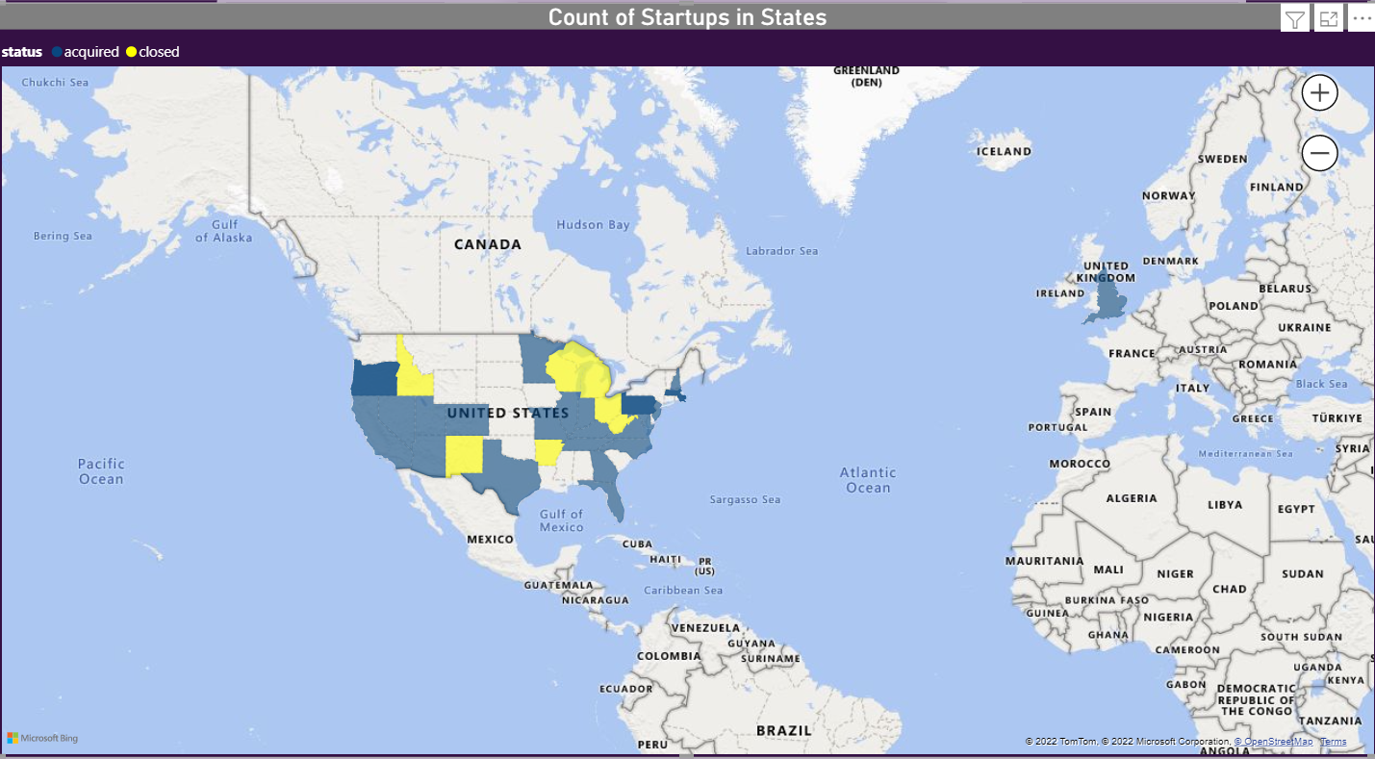
The bar chart show us the Category that has achieved the maximum of milestones.
With the help of map chart we can track the location where the startup is acquired or closed.

Slide 21
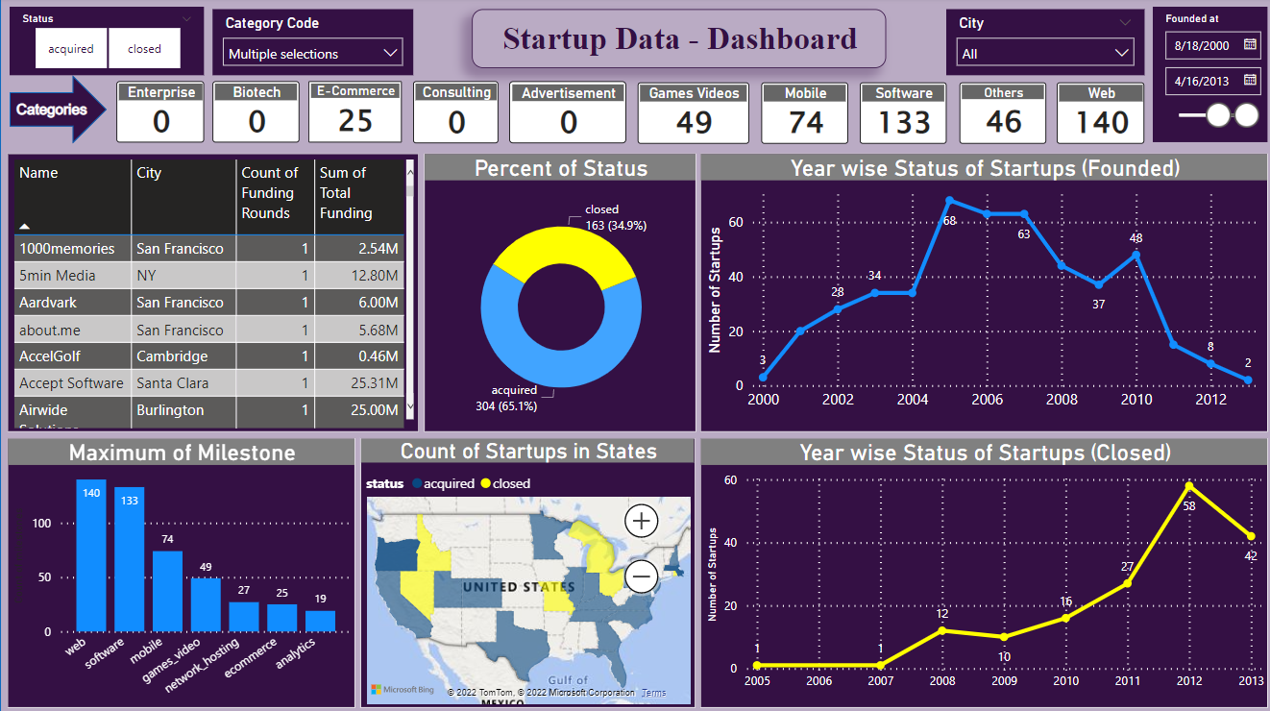
Insight Screenshot

Slide 22
Important Insights
As we have gone through the data and our dashboard, we saw that each category related to internet and technology was started after the year 2000. So we can say that year 2000 was the beginning of tech era. People were more focused on internet and technology as compared to the traditional business.
In the previous slide, we can see in the map chart by selecting the slicers like category code with results related to internet and technology and a Date-Time from 2000 onwards, we get to know that after the year 2000 there was a rise in the market share of internet and technology start-ups. So we can conclude after year 2000 the market was ready for internet exposure and getting online.

Slide 23


